Slide 1

DADI INSTITUTE OF ENGINEERING & TECHNOLOGY
EMOTION RECOGNITION USING SPEECH PROCESSING
BY
M . Nagalakshmi (20U41A0541)
A. Mahitha Sri Varshini (20U41A0537)
D . Saathvika (20U41A0554)
B . Bhargavi(20U41A0544)
Under the Supervision of
P. Uday Bhaskar , Assistant Professor, CSE
Dadi Institute of Engineering & Technology
DEPARTMENT OF ELECTRONICS & COMMUNICATION ENGINEERING
DADI INSTITUTE OF ENGINEERING & TECHNOLOGY
(AN AUTONOMOUS INSTITUTE)
ANAKAPALLE - 531002, VISAKHAPATNAM, A.P.
MARCH - 2024

Slide 2
ABSTRACT
Emotion recognition using speech processing has emerged as a pivotal research area with applications spanning from human-computer interaction to mental health diagnosis. This study investigates the extraction of emotional cues embedded within speech signals to discern underlying emotional states. Through sophisticated signal processing techniques and machine learning algorithms, such as Support Vector Machines (SVMs) and Convolutional Neural Networks (CNNs), the research aims to decipher nuanced emotional expressions including joy, sadness, anger, and more. Key aspects of the investigation include feature extraction methodologies to capture relevant acoustic properties, dataset curation for model training and evaluation, and algorithmic advancements to enhance recognition accuracy and robustness across diverse linguistic and cultural contexts. The findings of this research hold significant implications for fields such as affective computing, virtual assistants, and mental health monitoring systems. Ultimately, the pursuit of effective emotion recognition through speech processing promises to enrich human-computer interaction paradigms, paving the way for more empathetic and context-aware technological interfaces.
D
I
E
T

Slide 3
INTRODUCTION
Emotion recognition using speech processing is a fascinating field where computers learn to understand how people feel just by listening to their voices. Imagine if a computer could tell if you're happy, sad, or angry just by hearing you talk! This technology uses advanced algorithms to analyze the tone, pitch, rhythm, and even the words we use when we speak to figure out our emotions. By studying these patterns, computers can help us better understand human emotions and create tools that respond to our feelings in more meaningful ways. It's like teaching computers to understand the language of emotions, opening up new possibilities for how we interact with technology and each other..
Emotion recognition using speech processing utilizes computational techniques to analyze speech signals and extract emotional content.
Various features including pitch, intensity, rhythm, and spectral characteristics of speech are examined for emotion classification.
D
I
E
T

Slide 4
Machine learning algorithms are trained to differentiate between different emotional states like happiness, sadness, anger, or neutrality.
Supervised learning techniques, including support vector machines (SVM), neural networks, are commonly used to classify emotions based on extracted features.
Emotion recognition technology can assist in diagnosing and monitoring mental health conditions, such as depression, anxiety .
D
I
E
T

Slide 5
EXISTING SYSTEM
Existing System utilizes deep learning models to analyze speech signals and extract features crucial for recognizing emotions.
Involves preprocessing of audio data to enhance signal quality and normalize input formats.
Employs feature extraction methods like Mel-frequency cepstral coefficients (MFCCs) and spectral features to capture acoustic characteristics of speech.
Utilizes deep neural network architectures such as Convolutional Neural Networks (CNNs) or Recurrent Neural Networks (RNNs).
Trains the model on labeled datasets comprising speech samples annotated with corresponding emotions.
Validates and fine-tunes the model using techniques like cross-validation to ensure generalization to unseen data.
Provides real-time or batch processing capabilities for analyzing speech inputs and accurately predicting emotions.
D
I
E
T

Slide 6
DRAWBACKS OF EXISTING SYSTEM
Variability: Emotions are subjective and can vary greatly among individuals.
Context dependence: Emotions can be influenced by context, making it challenging to accurately interpret.
Cultural differences: Emotional expression differs across cultures, leading to misinterpretations
Ambiguity: Speech may convey mixed emotions or lack clear emotional cues.
Computational complexity: Emotion recognition algorithms can be resource-intensive.
D
I
E
T

Slide 7
PROPOSED SYSTEM
The goal of this project is to design and implement a system that can recognize emotions from speech using speech processing techniques. The system architecture consists of several stages. In the preprocessing stage, voice activity detection is performed to remove non-speech segments, followed by feature extraction to extract relevant features such as MFCCs, pitch, energy, and formants. Feature selection techniques like PCA or Information Gain are then applied to choose a subset of features that discriminate well between different emotions. The selected features are used to train a machine learning model, which can be SVMs, CNNs, or LSTM networks, to classify emotions. Post-processing techniques can be applied to refine the classification results based on context or by combining outputs from multiple models. The system requires an appropriate dataset for training and testing, such as IEMOCAP or RAVDESS.
D
I
E
T

Slide 8
ADVANTAGES OF PROPOSED SYSTEM
Human-Computer Interaction Improvement: Emotion recognition enhances human-computer interaction by enabling systems to understand and respond to users' emotional states. This fosters more natural and intuitive interactions, improving the overall user experience.
Personalized User Experiences: Tailoring interactions based on recognized emotions allows systems to provide personalized experiences. For instance, virtual assistants can adapt responses to users' emotional needs, creating a more empathetic and user-centric environment.
Customer Service Enhancement: In customer service applications, emotion recognition aids in gauging customer sentiment during interactions. This information can be utilized to improve service quality, address concerns promptly, and enhance overall customer satisfaction.
Mental Health Monitoring: Emotion recognition in speech processing holds potential for monitoring mental health. By analyzing speech patterns, systems can identify potential signs of emotional distress or changes in mood, offering opportunities for early intervention and support.
D
I
E
T

Slide 9
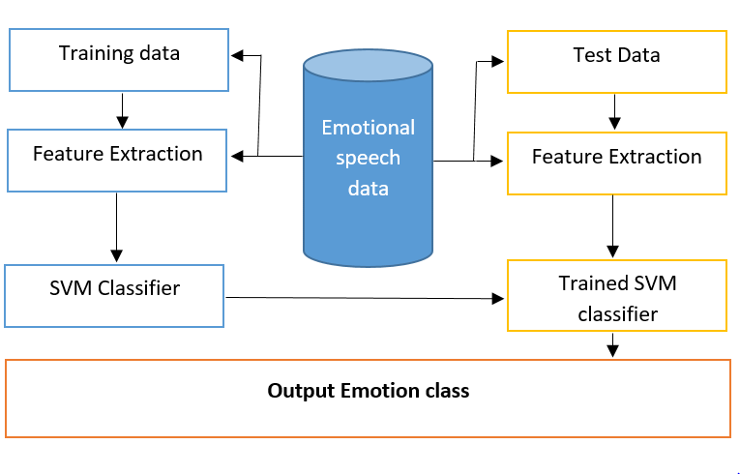
SYSTEM ARCHITECTURE
D
I
E
T

Slide 10
PROCESS FLOW
Developing an emotion recognition system using speech processing
Data collection
Preprocessing
Feature extraction
Feature Selection
Model Training
Model Evalution
Model Optimization
Integration and deployment
D
I
E
T

Slide 11
Software Requirements
OS :Windows 10
Programming language :Python
ANACONDA 3-64bit
Jupiter Notebook
D
I
E
T

Slide 12
HARDARE REQUIRREMENTS
Processor :intel corei3
Hard disk:250GB
RAM :8GB and good internet connection
Devices Required :Speaker
D
I
E
T

Slide 13
Modules
Python libraries like Librosa , PyAudio and Speech Recognition for audio processing and feature extraction.
Scikit-learn, TensorFlow, for building and training machine learning or deep learning models.
OpenSMILE , a feature extractor tool specifically designed for speech and audio signals.
Jupiter Notebooks for interactive development and experimentation.
D
I
E
T

Slide 14
Functional Requirements
Audio Input Processing: The system should be able to receive audio inputs from various sources like microphones or pre-recorded files and process them for emotion analysis.
Preprocessing: Before emotion analysis, the system needs to enhance audio quality by reducing noise and segmenting the audio into smaller parts for analysis.
Feature Extraction: Extracting relevant acoustic features from audio, such as pitch, intensity, and spectral characteristics, to represent emotional content effectively.
Emotion Classification: Implementing algorithms to classify extracted features into predefined emotion categories (e.g., happy, sad) using machine learning or deep learning techniques
Model Integration and Deployment: Integrating trained models into the system and deploying them across different platforms and environments like desktop applications or mobile apps.
D
I
E
T

Slide 15
Model Integration and Deployment: Integrating trained models into the system and deploying them across different platforms and environments like desktop applications or mobile apps.
User Interface: Providing a user-friendly interface for users to interact with the system, upload audio files, and visualize emotion recognition results.
D
I
E
T

Slide 16
Non-Functional Requirements
Performance:
Response Time: The system should provide timely responses to user queries and process audio inputs efficiently.
Throughput: It should be capable of handling multiple audio inputs concurrently without significant degradation in performance.
Scalability: The system should be able to scale horizontally or vertically to accommodate increasing loads or processing demands.
Usability:
User Interface Design: The interface should be intuitive, easy to navigate, and aesthetically pleasing.
Accessibility: The system should be accessible to users with disabilities, complying with relevant accessibility standards.
Documentation: Comprehensive documentation should be provided to guide users on system usage, features, and troubleshooting.
D
I
E
T

Slide 17
BLOCK DIAGRAM
Load the Input Speech
Apply Filter and Remove the Noise
Extract the Feature MFCC feature
Train With Neural Network
Simulate Network
If Match Found?
No
End
Yes
Emotion Recognized
End
D
I
E
T

Slide 18
UML DIAGRAMS
USECASE DIAGRAM
Speech Emotion Recognition
Input Audio
Saving Audio File
Load Audio
Feature Extraction
System
User
Predicting Emotion
Display Emotion
View Emotion
D
I
E
T

Slide 19
SEQUENCE DIAGRAM
User
Audio
Microphone
Main
Hidden Markov
Load
Record
Samples
Capture
Samples
Load Model
Recognize
Probability
D
I
E
T

Slide 20
STATE DIAGRAM
Input Audio
Load trained model
Audio Recognition
Saving audio file
Audio Extraction
Feature Extraction
Predicting Emotion
Display Emotion as Emoji
D
I
E
T

Slide 21
IMPLEMENTATION
Implementing speech emotion recognition involves several technical steps.
1. Dataset Selection and Preparation:
Choose a dataset suitable for speech emotion recognition, such as the (RAVDESS) or the Berlin Database of Emotional Speech .
Ensure the dataset has audio files labeled with different emotions.
2. Data Preprocessing:
Load audio files from the dataset.
Preprocess the audio data to remove noise, silence, and normalize volume levels.
Segment the audio files into smaller frames (e.g., using Hamming windowing) to prepare for feature extraction.
D
I
E
T

Slide 22
3. Feature Extraction:
Extract relevant features from the preprocessed audio frames. Common features include:
Mel-frequency cepstral coefficients (MFCCs) to capture spectral characteristics.
Energy and spectral features.
Use libraries like Librosa or Python Speech Features for feature extraction.
4. Model Selection and Training:
Choose a machine learning model or deep learning architecture suitable for emotion recognition, such as:
Support Vector Machines (SVM), Gaussian Mixture Models (GMM), or Random Forests for traditional machine learning approaches.
Convolutional Neural Networks (CNNs),
Split your dataset into training and testing sets.
D
I
E
T

Slide 23
5. Model Evaluation:
- Evaluate the trained model using the testing dataset.
- Calculate evaluation metrics such as accuracy, precision, recall, and F1-score to assess the model's performance.
- Analyze confusion matrices to understand how well the model predicts different emotions.
6. Deployment:
- Once satisfied with the model's performance, deploy it in your application or system.
- Integrate the model with speech input mechanisms to analyze real-time audio and predict emotions.
- Ensure the system's usability and performance meet the desired requirements in the target environment.
D
I
E
T

Slide 24
Testing
Unit Testing : Tests individual components or modules in isolation to ensure they function correctly.
Integration Testing : Verifies that different components of the system work together as expected when integrated.
Functional Testing : Validates whether the system meets its functional requirements and performs its core tasks accurately.
Performance Testing : Evaluates the system's speed, scalability, and resource usage under different conditions to optimize performance.
D
I
E
T

Slide 25
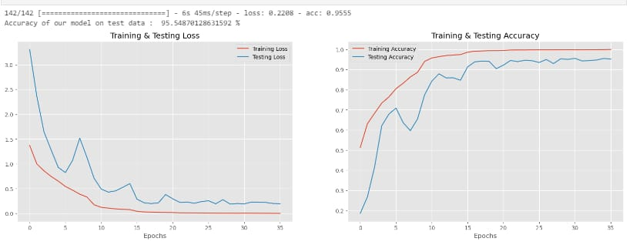
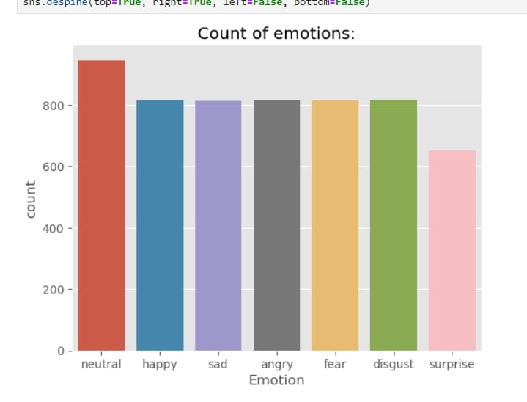
Results
The above output is the count of the audio files in various emotions
The output is the accuracy of the final testing of audio . here we got the 95% of accuracy of the audio file.
D
I
E
T

Slide 26
CONCLUSION
Speech emotion recognition (SER) is a burgeoning field with profound implications for human-computer interaction and affective computing. Leveraging advancements in machine learning and signal processing, researchers strive to develop models capable of discerning emotional states from speech patterns. Despite progress, challenges persist, including the need for diverse, well-annotated datasets and addressing real-world variability in speech signals and cultural contexts . Deep learning architectures, notably convolutional and recurrent neural networks, show promise but require ongoing refinement to enhance interpretability, reduce overfitting, and improve generalization across demographics. Multimodal approaches, integrating speech with other modalities like facial expressions or physiological signals, offer avenues for more robust emotion recognition systems . While facing hurdles, SER finds applications in virtual assistants, mental health monitoring, and human-computer interaction. Collaboration between academia and industry remains vital to address limitations, refine models, and ensure ethically sound deployments. SER's evolution marks the convergence of technology and human emotion, offering potential for more empathetic and responsive systems in our increasingly digital world.
D
I
E
T

Slide 27
THANK YOU
D
I
E
T

